Slide 1
Simple Linear Regression
Univariate Regression Technique

Slide 2
Deterministic Relationships
In a Deterministic Relationship, the equation exactly describes the relationship between the two variables.

Slide 3
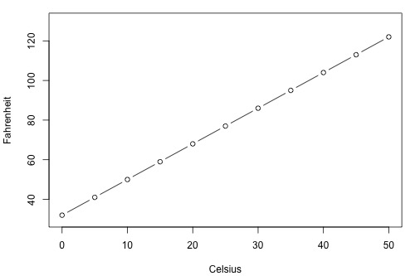
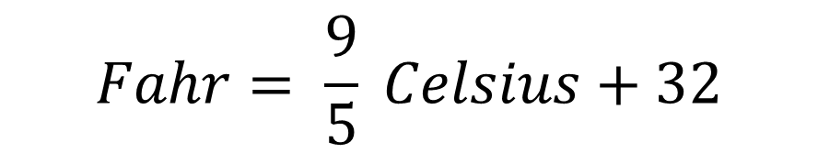
Deterministic Relationship Example: (Relationship between Fahrenheit & Celsius)
Relationship is defined as :
$$Fahr= \frac{9}{5} Celsius+32$$

Slide 4
Some other examples of Deterministic Relationships:
Circumference = π × diameter
Hooke's Law: Y = α + βX
where Y = amount of stretch in a spring, and X = applied weight.
Ohm's Law: I = V/r
where V = voltage applied, r = resistance, and I = current.
Boyle's Law: For a constant temperature, P = α/V
where P = pressure, α = constant for each gas, and V = volume of gas.

Slide 5
Statistical Relationships
Here, the relationship between the numerical continuous variables is not perfect.

Slide 6
Some examples of Statistical Relationship:
Height and weight — as height increases, you'd expect weight to increase, but not perfectly.
Alcohol consumed and blood alcohol content — as alcohol consumption increases, you'd expect one's blood alcohol content to increase, but not perfectly.
Vital lung capacity and pack-years of smoking — as amount of smoking increases (as quantified by the number of pack-years of smoking), you'd expect lung function (as quantified by vital lung capacity) to decrease, but not perfectly.
Driving speed and gas mileage — as driving speed increases, you'd expect gas mileage to decrease, but not perfectly.

Slide 7
Linear Regression
In simple words linear regression is predicting the value of a variable y(dependent variable) based on some variable X(independent variable) provided there is a linear relationship between X and y.
Simple linear regression is a statistical method that allows us to summarize and study relationships between two continuous (quantitative) variables.
This linear relationship between the 2 variables can be represented by a straight line (called Regression line).

Slide 8
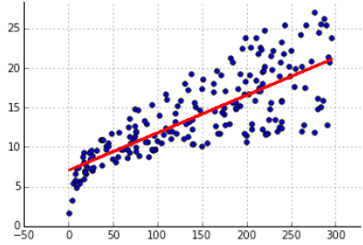
Seems to be a Linear Relationship between the Independent & the Dependent Variable

Slide 9
No Linear Relationship between the Independent & the Dependent Variable

Slide 10
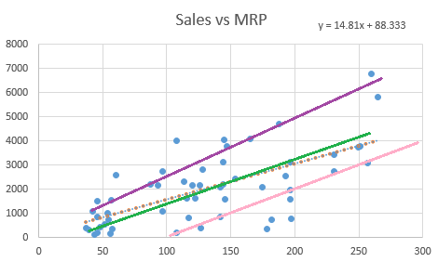
Best Fitting Line

Slide 11
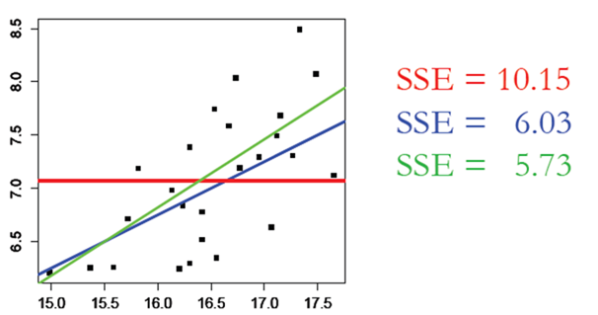
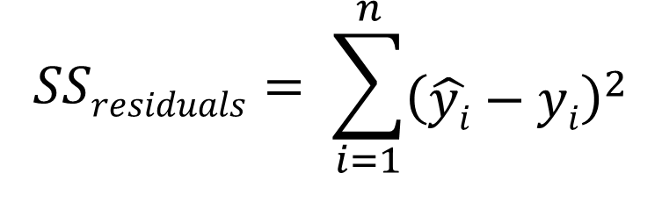
Sum of Squares of Residuals or Ordinary Least Squares
$$SSresiduals= \sum_{i=1}^{n}{{\left(\hat{yi}−yi\right)}^{2}}$$

Slide 12
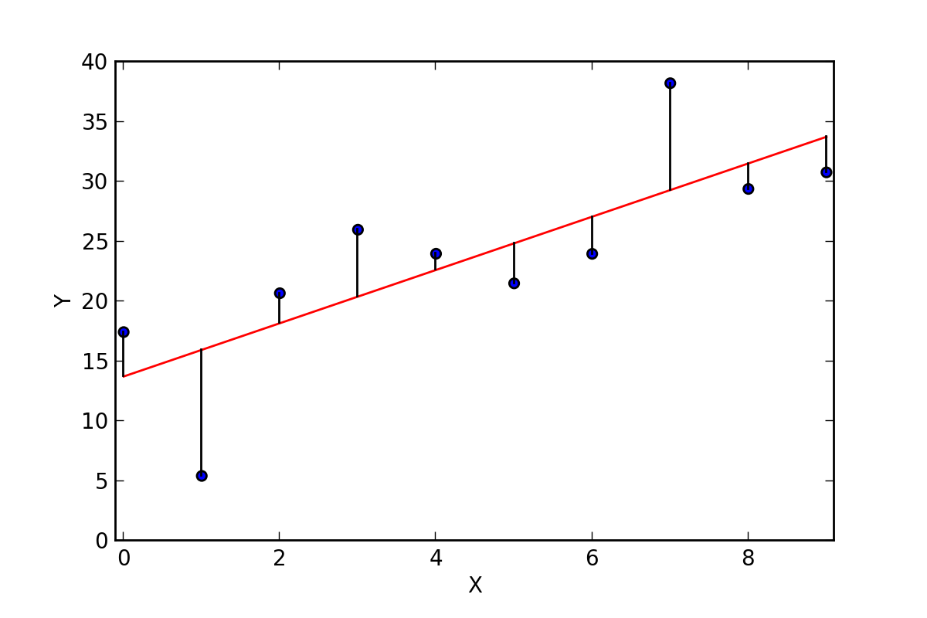
Residuals

Slide 13

Cost Function

Slide 14
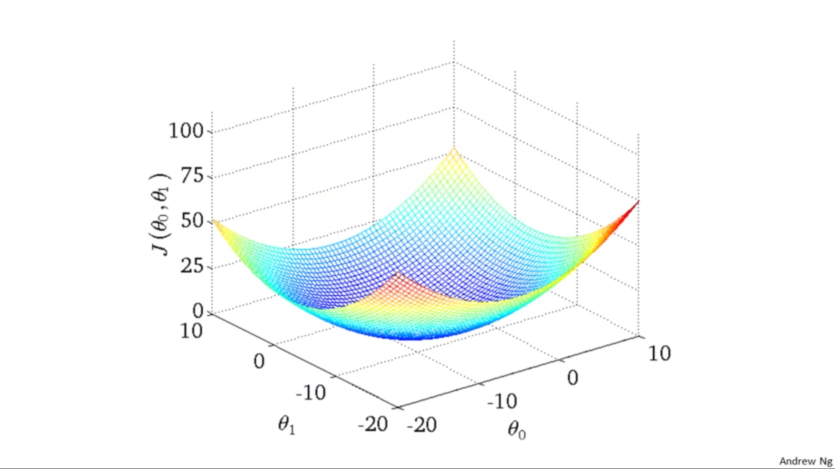

Slide 15
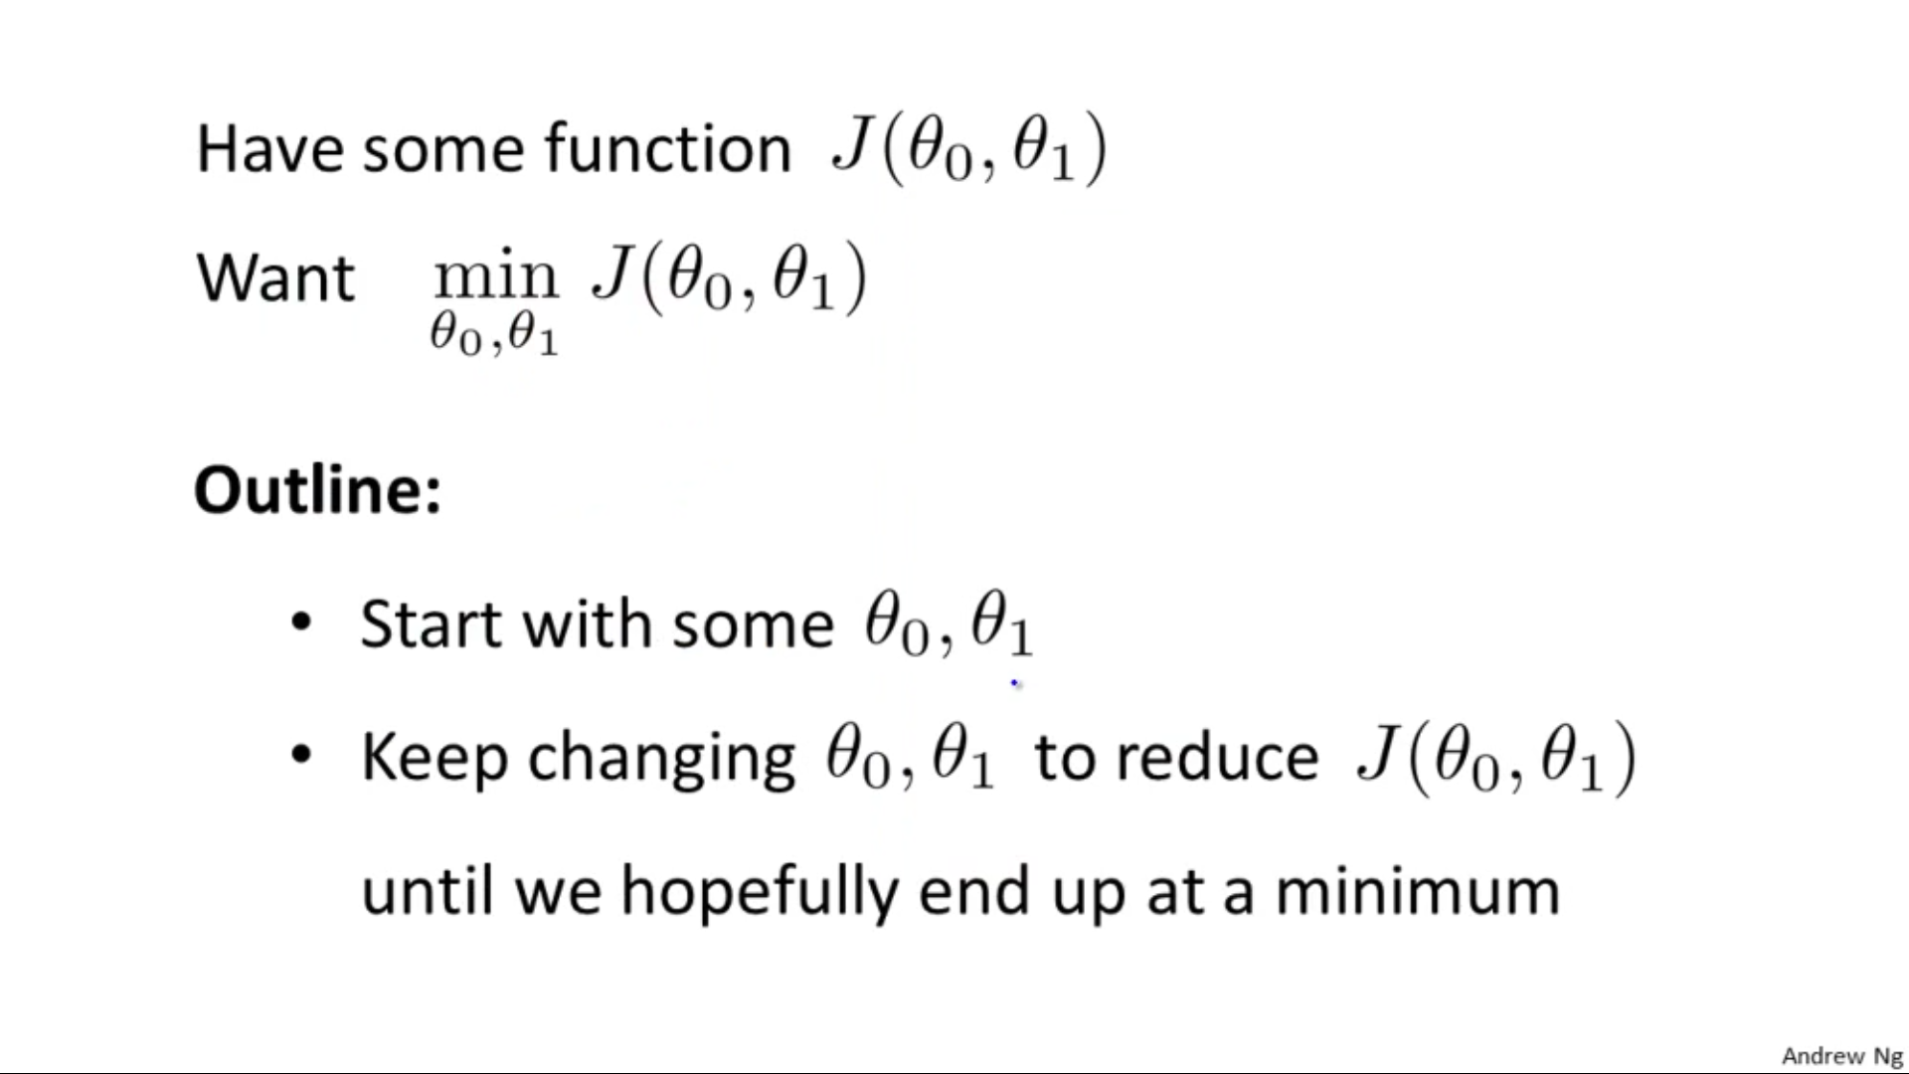
Gradient Descent

Slide 16
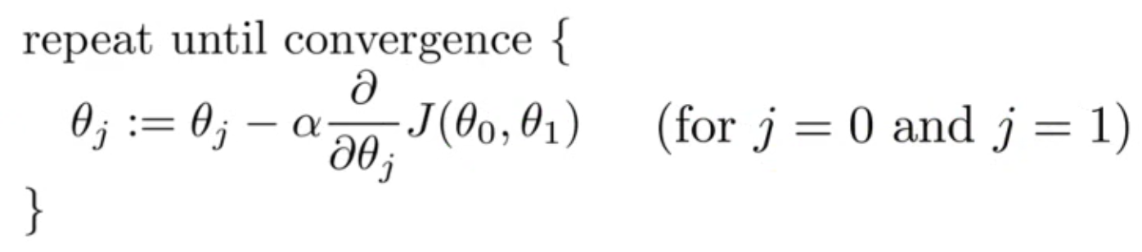
Gradient Descent Function

Slide 17
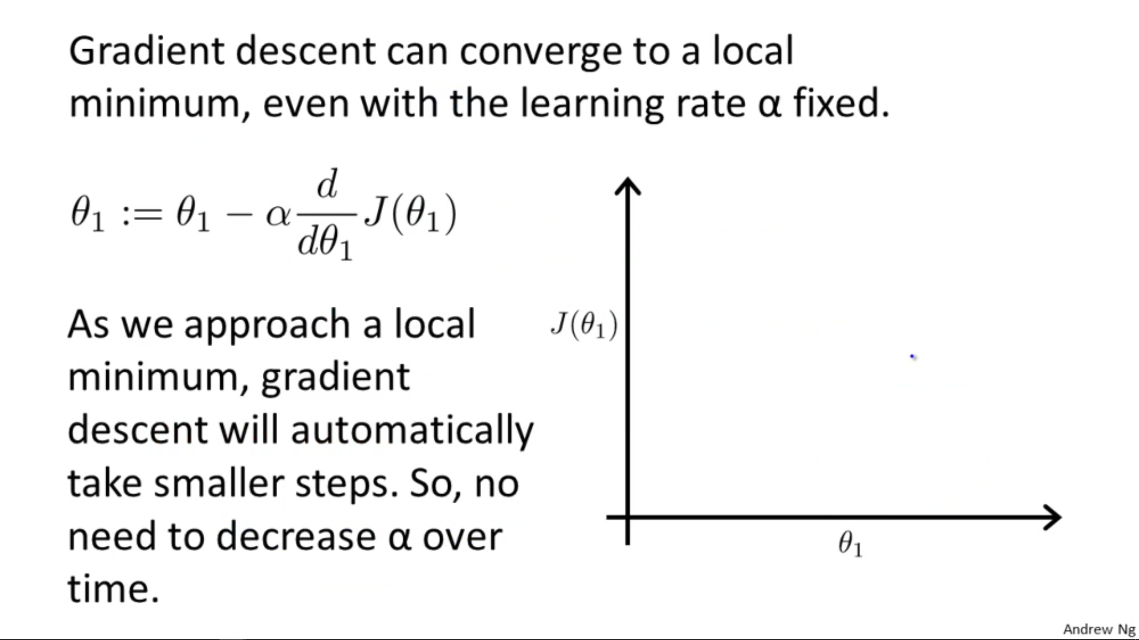
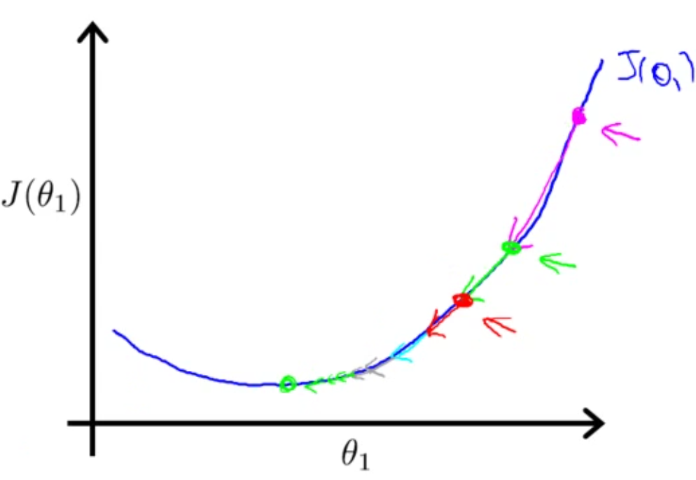

Slide 18
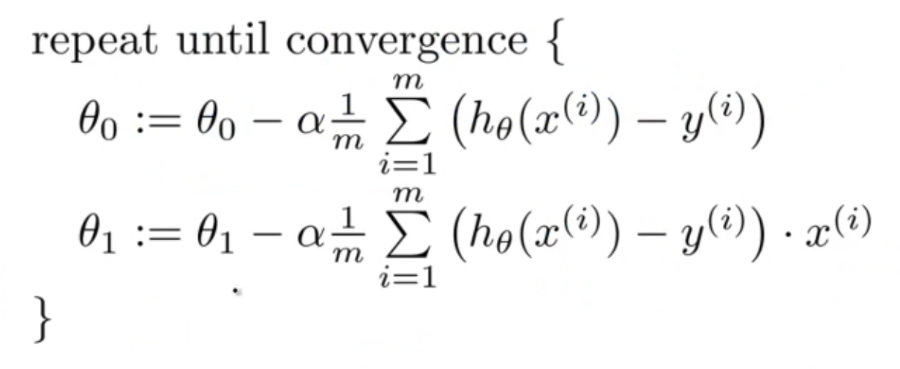
Gradient Descent (Simplified)

Slide 19
Remember
Remove Outliers from your dataset since Linear Regression models are susceptible to outliers.

